Slide 1
Web - BasiCs.
.NET & JS Lab
Anzhelika KRAVCHUK

Slide 2

What is the Internet?
The Internet is the wide computer network integrating local area networks the enterprise ̆ both the organizations ̆ and computers of certain users ̆ in the general information space, constructed on use of the IP protocol and routing of data packets. The Internet represents the infrastructure for application-oriented services of different function (the failoobmennykh, mail, hypertext and so forth)

Slide 3
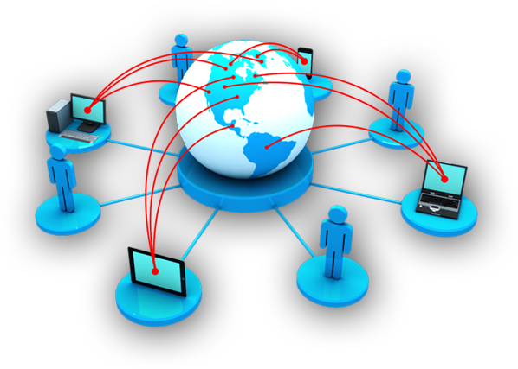


What is WWW?
World Wide Web (WWW, web, web, World Wide Web) is the distributed information system providing access to hypertext documents according to the HTTP protocol (HyperText Transfer Protocol)
WWW is the network technology of the application layer of a stack TCP/IP constructed on the client to architecture and using infrastructure the Internet for interaction between the server and the client
http://net.e-publish.ru/p214aa1.html

Slide 4

What is WWW?
The first-ever website info.cern.ch appeared on December 20, 1990. His creator, Tim Berners-Lie, published on him the description of the new World Wide Web technology based on the data transfer protocol HTTP, an addressing system of URI and language of a hypertext marking of HTML. Also on the website the principles of installation and operation of servers and browsers were described.
Notes:
https://ru.wikipedia.org/wiki/%D0%A1%D0%B0%D0%B9%D1%82
Первый[1] в мире сайт info.cern.ch появился 20 декабря 1990 года[2][3][4][уточнить]. Его создатель, Тим Бернерс-Ли, опубликовал на нём описание новой технологии World Wide Web, основанной на протоколе передачи данных HTTP, системе адресации URI и языке гипертекстовой разметки HTML. Также на сайте были описаны принципы установки и работы серверов и браузеров.

Slide 5
Software of the www service
Web server
Browser
HTTP Request
Files
HTTP server
HTTP Response
Web server – the program launched on the networked PC, expecting client requests and transferring data on the HTTP protocol
Browser – the client application for access to Web servers according to the HTTP protocol and web browsing
Notes:
Хранит ресурсы сайта (HTML документы, CSS стили, JavaScript файлы и другое) и доставляет их на устройство конечного пользователя (веб-браузер и т.д.). Обычно подключен к сети Интернет и может быть доступен через, доменное имя, например mozilla.org. mozilla.org.
ПО, контролирующее доступ пользователей к размещенным на сервере файлам (минимум HTTP сервера). HTTP сервер это часть ПО которая понимает URL’ы (веб-адреса) и HTTP (протокол который использует браузер для просмотра веб-станиц).
https://developer.mozilla.org/ru/docs/Learn/%D0%A7%D1%82%D0%BE_%D1%82%D0%B0%D0%BA%D0%BE%D0%B5_%D0%B2%D0%B5%D0%B1_%D1%81%D0%B5%D1%80%D0%B2%D0%B5%D1%80
Веб-сервер — это сетевое приложение, обслуживающее HTTP-запросы от клиентов, обычно веб-браузеров. Веб-сервер принимает запросы и возвращает ответы, обычно вместе с HTML-страницей, изображением, файлом, медиа-потоком или другими данными. Веб-серверы — основа Всемирной паутины. С расширением спектра сетевых сервисов веб-серверы все чаще используются в качестве шлюзов для серверов приложений или сами представляют такие функции (например, Apache Tomcat).

Slide 6
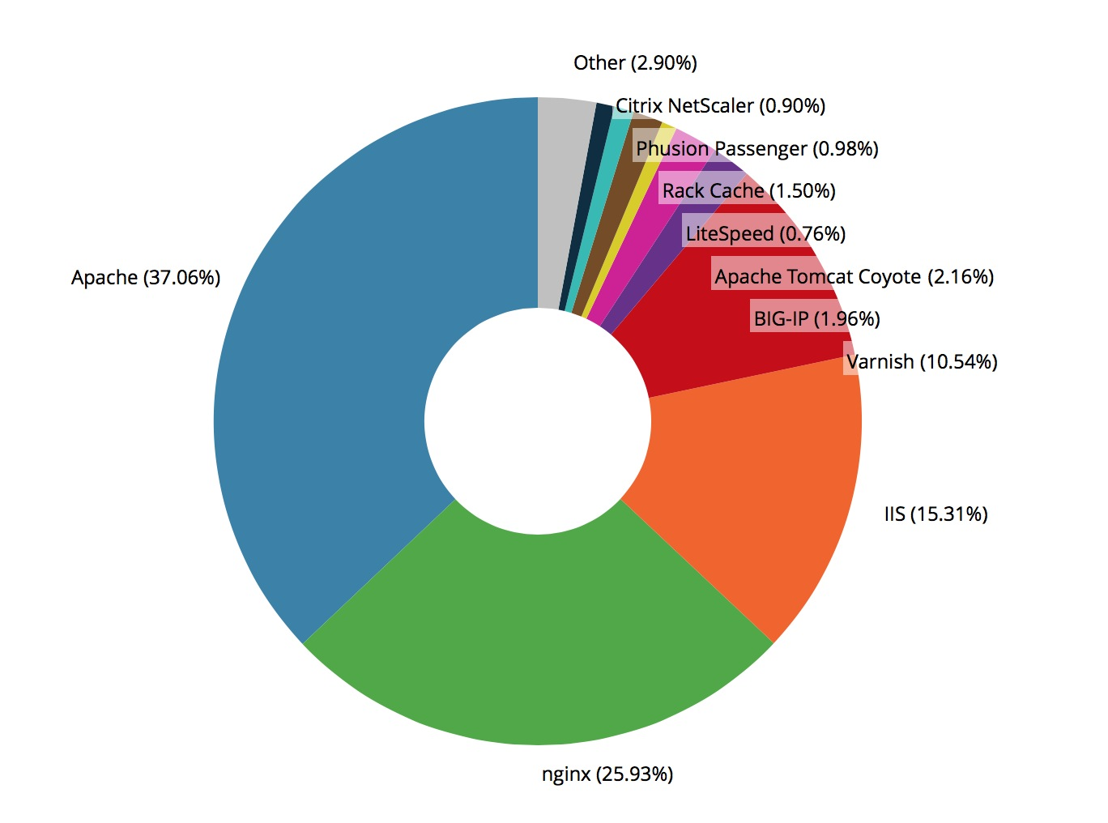
Software of the www service

Slide 7
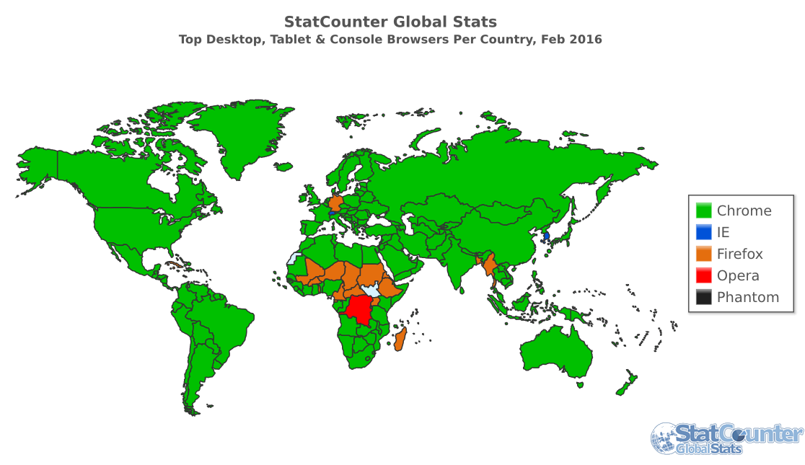
Software of the www service
http://gs.statcounter.com/

Slide 8
Service components
Functioning of service is provided with four components:
URL/URN/URI — the unified addressing mode and identifications of network resources;
HTML — language of a hypertext marking of web documents;
HTTP — the hypertext transfer protocol;
CGI — the general lock interface representing access to server applications.

Slide 9
Addressing of web resources. URL, URN, URI
port
query
http://www.domain.com:1234/path/to/resourse?a=b&x=y
protocol
host
resource path
URI — Uniform Resource Identifier (the unified resource identifier)
URL — Uniform Resource Locator (the unified resource location determinant) (Where? How?)
URN — Unifrorm Resource Name (uniform resource name) (Who? What?)

Slide 10
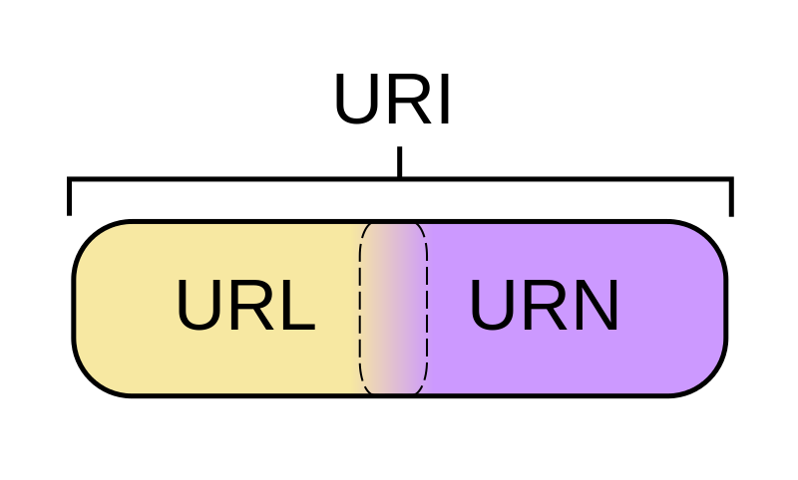
Addressing of web resources. URL, URN, URI
URI = http://handynotes.ru/2009/09/uri-url-urn.html
URL = http://handynotes.ru
URN = /2009/09/uri-url-urn.html
URI is a concept of the abstract identifier whereas URL and URN specific implementation — the address and a name
http://www.w3schools.com/tags/ref_urlencode.asp

Slide 11
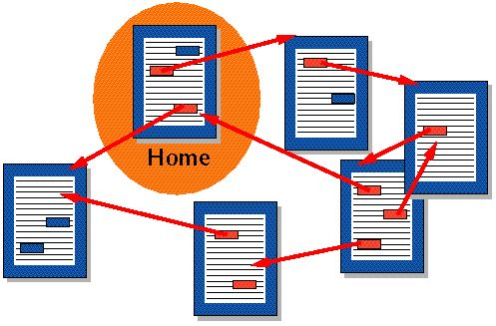
Language of a hypertext marking of HTML
The main type of resources of the World Wide Web — hypertext pages. The hypertext is the literal text labeled by the special controlling constructions — tags. The browser reads out tags and interprets them as formatting commands on the information output. Tags describe structure of the document, and special tags, anchors and hyperlinks, allow to establish connection between web pages and to move both in the web site, and between the websites.
Notes:
Основной тип ресурсов Всемирной паутины — гипертекстовые страницы. Гипертекст — это обычный текст, размеченный специальными управляющими конструкциями — тегами. Браузер считывает теги и интерпретирует их как команды форматирования при выводе информации. Теги описывают структуру документа, а специальные теги, якоря и гиперссылки, позволяют установить связи между веб-страницами и перемещаться как внутри веб-сайта, так и между сайтами.
Документы, представленные в виде гипертекста называются web-страницами. Несколько web-страниц, объединенных общей тематикой, оформлением, связанных гипертекстовыми ссылками и обычно находящихся на одном и том же web-сервере, называются web-сайтом

Slide 12
Language of a hypertext marking of HTML
HTML (HyperText Markup Language) — a standard markup language of documents in the World Wide Web. The majority of web pages are created by means of the HTML language. The HTML language is interpreted by the browser and displayed in the form of the document, in the form, convenient for the person. HTML is application of SGML (standard generalized markup language) and conforms to the international ISO 8879.
https://www.w3.org/TR/html5/
https://html.spec.whatwg.org/

Slide 13
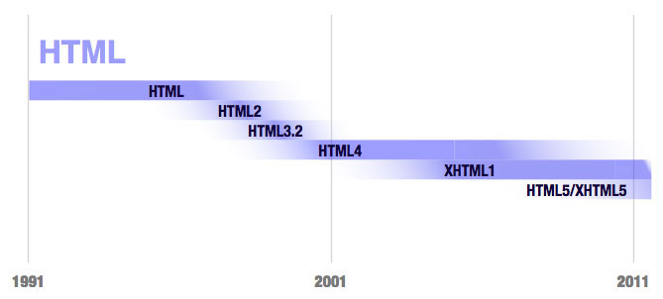
Language of a hypertext marking of HTML
Notes:
http://professorweb.ru/my/html/html5/level1/1_1.php
Версии HTMLRFC 1866 — HTML 2.0, — 22.09.1995г.; HTML 3.2 — 14.01.1997г.;HTML 4.0 — 18.12.1997г.;HTML 4.01 — 24.12.1999г.;ISO/IEC 15445:2000 (ISO HTML, основан на HTML 4.01 Strict) — 15.05.2000г.; HTML 5 — с 2004 г. в разработке.Официальной спецификации HTML 1.0 не существует. До 1995г. существовало множество неофициальных стандартов HTML. Чтобы стандартная версия отличалась от них, ей сразу присвоили второй номер.Версия 3.1 официально никогда не предлагалась, и следующей версией стандарта HTML стала 3.2.В HTML 4.0 добавлены специфичные элементы, а некоторые теги были отмечены как устаревшие и нерекомендованные

Slide 14


HTTP protocol
In Bhutan when people get acquainted, they usually welcome each other the words "Your Body Feels Well?". In Japan they can bow, depending on a situation. In Oman men usually kiss each other on a nose, after handshake. In Cambodia and Thailand they usually connect palms, as in case of a prayer. All this protocols of communication, the simple sequence of rules which matters and prepares both sides for information exchange.
Hypertext Transfer Protocol or HTTP is the effective application layer protocol which prepares computers for information exchange
http://www.tutorialspoint.com/http/index.htm
Notes:
http://www.tutorialspoint.com/http/http_messages.htm

Slide 15

HTTP protocol
The quote from Wikipedia:
HTTP (abbr. from the English HyperText Transfer Protocol — "hypertext transfer protocol") — the application layer protocol of data transfer. A basis of the HTTP protocol is the client-server Technology, that is existence of customers (clients, users) who initiate connection is supposed and send a request, and suppliers (servers) which expect connection of clients for receiving a request make necessary actions and return back the message with result.
The main subject to manipulation in HTTP is the resource which specifies URI (Uniform Resource Identifier – a unique identifier of a resource) in the client's request. The main resources are the files which are stored on the server, but others logical (e.g. the directory on the server) or the abstract objects (e.g. ISBN) can be them also. The HTTP protocol allows to specify a method of representation (coding) of the same resource in different parameters: to mime-type, language etc. Thanks to this opportunity the client and a Web server can exchange binary data though this protocol is text.

Slide 16
HTTP transaction
Request Message
GET /home.html HTTP/1.1
Host: xyz.com
Connection: keep-alive
Accept: image/gif,image/jpeg
User-Agent: Mozilla/5.0
Accept-Encoding: ...
-------blank line------
(empty body)
Starting line
Headers
Message Body
HTTP Client(s)
HTTP Server
http://xyz.com/home.html
Server-side
Programs
Client-side
Programs
Response Message
HTTP/1.1 200 OK
Cache-Control: private
Content-Type: text/html
Server: Microsoft-IIS/8.5
X-AspNetMvc-Version: 5.2
X-AspNet-Version: 4.0.30319
X-Powered-By: ASP.NET
Date: Sun, 14 Feb 2016 12:01:51 GMT
Content-Length: 44581
-------blank line------
<html>
<head><title>Home</title></head>
...
Starting line
Headers
Message Body
Notes:
Когда в браузере запрашивается Web-страница, то последовательность событий, вызванная таким действием, может рассматриваться как транзакция HTTP

Slide 17
Structure of the HTTP protocol
The structure of the protocol defines that each HTTP message consists of three parts which are transferred in the following order:
The start line (English Starting line) — defines message type;
Titles (English Headers) — characterize a message body, parameters of transmission and other data;
Message body (English Message Body) — directly these messages. Shall separate from titles blank line.

Slide 18
Start line HTTP
The start line is a mandatory member as specifies request/response type, titles and a body of the message can be absent.
URI method NTTR/ProtocolVersion
Request-Line
GET /web-programming/index.html HTTP/1.1
StateCode [Explanation] HTTP/version
Status-Line
HTTP/1.1 200 Ok

Slide 19
HTTP protocol methods
The HTTP method (English HTTP Method) — the sequence from any characters, except managing directors and separators, specifying the main operation over a resource. Usually the method represents the short English word written by capital letters. Names of a method are sensitive to the register.

Slide 20
HTTP protocol methods
GET: to get access to the existing resource. In URL all necessary information that the server could find and return a required resource as the response is listed.
POST: it is used for creation of a new resource. POST a request usually comprises all necessary information for creation of a new resource.
PUT: to update the current resource. PUT a request contains updatable data.
DELETE: serves for deleting the existing resource.
HEAD: GET is similar. The difference is that in case of this type of a request the message isn't transferred. The server receives only titles. It is used, for example, to define whether the resource was changed.
TRACE: in transmission time the request passes through a set of access points and a proxy of servers, each of which enters the information: IP, DNS. By means of this method, it is possible to see all interim information.
OPTIONS: it is used for determination of opportunities of the server, its parameters and a configuration for a specific resource.

Slide 21
Методы GET и POST протокола HTTP
/test/demo_form.asp?name1=value1&name2=value2
GET запросы могут кэшироваться
GET запросы остаются в истории браузера
GET запросы могут быть закладками
GET запросы не должны использоваться при работе с конфиденциальными данными
GET запросы имеют ограничения длины
GET запросы должны быть использованы только для получения данных
POST /test/demo_form.asp HTTP/1.1 Host: w3schools.com name1=value1&name2=value2
POST запросы никогда не кэшируются
POST запросы не остаются в истории браузера
POST запросы не быть закладками
POST запросы не имеют ограничений по длине данных

Slide 22
Status codes
The status code informs the client on results of execution of a request and defines his further behavior. The set of status codes is the standard, and all of them are described in the relevant documents of RFC (Request for Comments).
Each code is represented the integral three-digit number. The first digit specifies a status class, subsequent - sequence number of a status. The response code is usually followed by the short description in English.
XXX
Код класса
Код сообщения
403

Slide 23
Status codes
Code class | Short description
1xx Informational | In this class the codes informing on transmission process are selected. In message HTTP/1.0 with such codes shall be ignored. In HTTP/1.1 the client shall be ready to accept this message class as the normal response, but it isn't necessary to send anything to the server. Messages from the server contain only a start line of the response and if it is required, several header fields, specific to the response. A proxy server similar messages shall be sent further from the server to the client. Examples of responses of the server: (To Continue) 100 Continue 101 Switching Protocols (Switching of protocols) 102 Processing (There is a processing)

Slide 24
Status codes
Code class | Short description
2xx Success | Messages of this class inform on cases of successful acceptance and processing of a request of the client. Depending on the status the server can transfer titles and a body of the message still. Examples of responses of the server: 200 OK (Successfully). 201 Created (Are created) 202 Accepted (Are accepted) 204 No Content (There are no contents) 206 Partial Content (Partial contents)

Slide 25
Status codes
Code class | Short description
3xx Redirection | Status codes of a class 3xx tell the client that it is necessary to make the following request to other URI for successful execution of operation. In most cases the new address is specified in the field of Location of title. The client in this case shall make automatic transition ("redirect"), as a rule. In case of the appeal to the following resource it is possible to receive the response from the same class of codes. Even the long chain of redirections which if are made automatically, will create excessive load of the equipment can turn out. Therefore developers of the HTTP protocol strongly recommend to request surely after the second in a row similar response confirmation on redirection from the user (it was recommended after the 5th earlier). The client as the current server can redirect the client on a resource of other server is obliged to track it. The client also shall prevent hit in circle redirections.

Slide 26
Status codes
Code class | Short description
3xx Redirection | Examples of responses of the server: 300 Multiple Choices (Multiple selection) 301 Moved Permanently (It is moved forever) 304 Not Modified didn't change) hit in circle redirections.

Slide 27
Status codes
Code class | Short description
4xx Client Error | The class of codes 4xx is intended for specifying of errors from client side. When using all methods, except HEAD, the server shall return in a message body the hypertext explanation for the user. Examples of responses of the server: 401 Unauthorized (Neavtorizovan) 402 Payment Required (Payment is required) 403 Forbidden (Are forbidden) 404 Not Found aren't found) 405 Method Not Allowed (The method isn't supported) 406 Not Acceptable aren't acceptable) 407 Proxy Authentication Required (Authentication of a proxy is required)

Slide 28
Status codes
Code class | Short description
5xx Server Error | Codes 5xx are selected under cases of unsuccessful execution of operation on fault of the server. For all situations, except use of the HEAD method, the server shall include an explanation which the client will display to the user in a message body. Examples of responses of the server: 500 Internal Server Error (Internal error of the server) 502 Bad Gateway (Bad gateway) 503 Service Unavailable (Service is unavailable) 504 Gateway Timeout (The gateway doesn't respond)

Slide 29
HTTP protocol titles
Title HTTP (HTTP Header) is the line in the HTTP message containing couple of look separated by a colon "parameter value". The format of title corresponds to the general format of titles of the text network messages ARPA (RFC 822). As a rule, the browser and a Web server include in messages more than on one title. Titles shall be sent before a body of the message and separate from it at least one blank line (CRLF).
The name of parameter shall consist at least of one printing character (ASCII codes from 33 to 126). After the name the colon character shall follow directly. Value may contain any characters of ASCII, except line feed (CR, a code 10) and carriage return (LF, a code 13).
Whitespace characters at the beginning and the end of value are cut off. The sequence of several whitespace characters in value can be perceived as one gap. The register of characters in the name and value doesn't matter (if other isn't provided by a field format).

Slide 30
HTTP protocol titles
HTTP Request Headers
GET http://smarly.net/ HTTP/1.1
Host: smarly.net
Connection: keep-alive
Accept: text/html,application/xhtml+xml,application/xml;q=0.9,image/webp,*/*;q=0.8
Upgrade-Insecure-Requests: 1
User-Agent: Mozilla/5.0 (Windows NT 6.3; WOW64) AppleWebKit/537.36 (KHTML, like Gecko) Chrome/48.0.2564.109 Safari/537.36
Accept-Encoding: gzip, deflate, sdch
Accept-Language: ru,en-US;q=0.8,en;q=0.6,it;q=0.4
Cookie: _ym_uid=144834572026550300; _ym_isad=1; _ga=GA1.2.20772410.1448345720
HTTP Response Headers
HTTP/1.1 200 OK
Cache-Control: private
Content-Type: text/html; charset=utf-8
Vary: Accept-Encoding
Server: Microsoft-IIS/8.5
X-AspNetMvc-Version: 5.2
X-AspNet-Version: 4.0.30319
X-Powered-By: ASP.NET
Date: Sun, 14 Feb 2016 12:01:51 GMT
Content-Length: 44581

Slide 31
HTTP protocol titles
All HTTP headers are divided into four main groups:
General Headers (The main titles) — join in messages of both the client, and the server.
Request Headers (Request titles) — are used only in the client's requests.
Response Headers (Response titles) — are present only at responses of the server.
Entity Headers (Entity titles) — accompany with each entity of the message.
Entities (entity, in translations also meets the name "object") is the useful information transferred in a request or the response. The entity consists of meta data (titles) and directly contents (a message body).
In a separate class titles of an entity are selected not to confuse them to titles of a request or titles of the response by transmission of multiple contents (multipart / *). Titles of a request and the response, as well as the main titles, describe all message in general and are placed only in a home block of titles while titles of an entity characterize contents of each part separately, settling down just before her body.
Notes:
http://ruseller.com/lessons.php?rub=28&id=1726
http://ruseller.com/lessons.php?rub=28&id=1777
http://code.tutsplus.com/tutorials/http-the-protocol-every-web-developer-must-know-part-1--net-31177

Slide 32
HTTP protocol titles
Title | Group | Short description
Allow | Entity | Method list, applicable to a required resource
Content-Encoding | Entity | It is applied in need of code conversion of contents (for example, gzip/deflated).
Content-Language | Entity | Localization of contents (language(s))
Content-Length | Entity | The message body size (in octets)
Content-Range | Entity | The range (it is used for maintenance of multithreaded loading or additional charge)
Content-Type | Entity | Specifies contents type (mime-type, for example text/html). Often includes specifying on the table of characters of a locale (charset)
Expires | Entity | Date/time after which the resource is considered outdated. It is used by proxy servers

Slide 33
HTTP protocol titles
Title | Group | Short description
Last-Modified | Entity | Date/time of the last modification of an entity
Connection | General | Sets the parameters required for specific connection
Date | General | Date and time of formation of the message
Pragma | General | It is used to special instructions which can (optionally) it is applied to any receiver on all chain of requests/responses (for example, pragma: no-cache)
Transfer-Encoding | General | Sets type of the conversion applicable to a message body. Unlike Content-Encoding this title extends to all message, and not just to an entity
Via | General | It is used by gateways and a proxy for display of the intermediate protocols and nodes between the client and a Web server

Slide 34
HTTP protocol titles
Title | Group | Short description
Warning | General | Additional information on a current status which can't be provided in the message
Accept | Request | Defines applicable data types, expected in the response
Accept-Charset | Request | Defines the character encoding (charset) for the data expected in the response
Accept-Encoding | Request | Defines applicable formats of coding/decoding of contents (напр, gzip)
Accept-Language | Request | Applicable languages. It is used for transmission coordination
From | Request | E-mail address of the sender
Host | Request | Name / network address [and port] servers. If the port isn't specified, 80 are used

Slide 35
HTTP protocol titles
Title | Group | Short description
If-Modified-Since | Request | It is used for execution of the conventional methods (Esli-Izmenilsya...). If the required resource changed, then it is transferred from the server, differently - from a cache
Referrer | Request | The address from which the request is executed. This title is absent if transition is executed from an address line or, for example, according to the link from javascript
User-Agent | Request | Information on the user agent (client)
Location | Request | Redirection address
Server | Request | Information on the software of the server responding to the request (it can be both web and a proxy server)

Slide 36
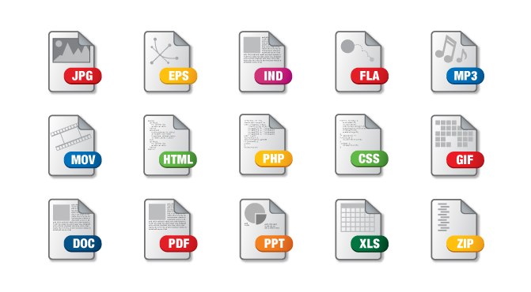
Internet Media Types
Internet Media Types — data types which can be transferred by means of the Internet using the MIME standard (Multipurpose Internet Mail Extension)

Slide 37
Message body
The body of HTTP of the message (message-body) if it is present, is used for transmission of the entity connected to a request or the response. The body of the message (message-body) differs from a body of an entity (entity-body) only in that case when by transmission the coding specified in Transfer-Encoding title is applied. In remaining cases the body of the message is identical to an entity body
The title of Transfer-Encoding shall go for specifying of any coding of transmission applied by application for the purpose of guaranteeing safe and correct transmission of the message. Transfer-Encoding is a property of the message, but not an entity, and it can be added or removed with any application in a chain of requests/responses
Presence of a body of the message at a request is marked by adding to titles of a request of a header field of Content-Length or Transfer-Encoding. The body of the message (message-body) can be added to a request only when the method of a request allows a body of an object (entity-body).
To Pvsa responses contain a body of the message, perhaps zero length, except replies to the request by HEAD method and responses with status codes 1xx (Information), 204 (There are no contents, No Content), and 304 (It isn't modified, Not Modified)

Slide 38
Extension of functions of Web servers. Common Gateway Interface
CGI (The general lock interface) is a standard of the interface used for communication of the external program with a Web server
CGI is the standard interface allowing to run the server applications caused through URL
as input information for such applications serve contents of the HTTP header or a body of a request
understand the programs written in any programming language as CGI programs (With, C ++, Perl, Pascal etc.), capable to be executed on the Web server
In case of each client request the server loads a CGU-application in a separate address space, and then initiates its execution and unloading
Notes:
http://www.di.unisa.it/~ads/corso-security/www/CORSO-9900/http/
Программа CGI - это консольное приложение, работающее в среде операционной системы сервера Web и осуществляющее обмен данными через стандартные потоки ввода и вывода. Такое приложение запускается только по запросу пользователя, когда к нему выполняется обращение из документа HTML. Окончив обработку запроса пользователя, программа CGI завершается

Slide 39
Extension of functions of Web servers. Common Gateway Interface
The CGI program is the console application which is working in the environment of an operating system of the Web server and realizing a data interchange through standard flows of input and output. Such application is started only at the request of the user when to it the address from the document HTML is executed. Having ended processing of a request of the user, the CGI program comes to the end
CGI Gateway
CGI script
stdin
HTTP Request
Receive
stdout
Process
CGI Response
stderr
Result
Notes:
Обобщенный алгоритм работы через CGI можно представить в следующем виде:
Клиент запрашивает CGI-приложение по его URI.
Веб-сервер принимает запрос и устанавливает переменные окружения, через них приложению передаются данные и служебная информация.
Веб-сервер перенаправляет запросы через стандартный поток ввода (stdin) на вход вызываемой программы.
CGI-приложение выполняет все необходимые операции и формирует результаты в виде HTML.
Сформированный гипертекст возвращается веб-серверу через стандартный поток вывода (stdout). Сообщения об ошибках передаются через stderr.
Веб-сервер передает результаты запроса клиенту.
http://www.di.unisa.it/~ads/corso-security/www/CORSO-9900/http/
http://www.4stud.info/web-programming/cgi.html
Программа CGI - это консольное приложение, работающее в среде операционной системы сервера Web и осуществляющее обмен данными через стандартные потоки ввода и вывода. Такое приложение запускается только по запросу пользователя, когда к нему выполняется обращение из документа HTML. Окончив обработку запроса пользователя, программа CGI завершается

Slide 40
Extension of functions of Web servers. ISAPI and DSO modules
The modular architecture of Web servers allows to expand their opportunities at the expense of external libraries — modules
Модули веб-сервера — это статически или динамически подключаемые библиотеки функций, доступных веб-серверу. В отличие от CGI, модульные расширения быстрее и требуют меньших ресурсов, т.к. многопоточны, т.е. для обработки еще одного запроса не требуется загрузки еще одной копии приложения. Модульные расширения наиболее распространенных веб-серверов: DSO (Dynamic Shared Objects) для веб-сервера Apache и ISAPI (Internet Server Application Program Interface) для Internet Information Services
Notes:
Модульная архитектура веб-сервера
Изначально, единственным средством выполнения программ на стороне веб-сервера было обращение к ним через общий шлюзовый интерфейс (CGI). Практика показала, что в CGI имеется ряд недостатков, в числе основных — высокие требования к аппаратным ресурсам веб-сервера и высокие накладные расходы на этапах загрузки и выгрузки CGI-приложений. Альтернативным решением стало использование модульной архитектуры веб-серверов, позволяющей расширять их возможности за счет внешних библиотек — модулей.
Модули веб-сервера — это статически или динамически подключаемые библиотеки функций, доступных веб-серверу. В отличие от CGI, модульные расширения быстрее и требуют меньших ресурсов, т.к. многопоточны, т.е. для обработки еще одного запроса не требуется загрузки еще одной копии приложения. Рассмотрим модульные расширения наиболее распространенных веб-серверов: DSO для веб-сервера Apache и ISAPI для Internet Information Services

Slide 41
ISAPI modules
ISAPI (Internet Server Application Programming Interface) is a set of the interfaces provided by a Web server of MS IIS (Internet Information Services) for applications writing interacting with this server and expanding its opportunities. Applications of ISAPI represent the dynamic link libraries (Dynamic Link Library, DLL) directly interacting with API IIS.
Applications of ISAPI are loaded and executed in an address space of IIS therefore the server doesn't need to create new process in case of each HTTP request. As Windows loads dynamic link library once in case of the first function invocation in DLL, application of ISAPI remains loaded and isn't deleted, the Web server (if ISAPI caching is included) won't be stopped/is switched off yet, or application won't be unloaded explicitly.
Notes:
Модульная архитектура веб-сервера
Изначально, единственным средством выполнения программ на стороне веб-сервера было обращение к ним через общий шлюзовый интерфейс (CGI). Практика показала, что в CGI имеется ряд недостатков, в числе основных — высокие требования к аппаратным ресурсам веб-сервера и высокие накладные расходы на этапах загрузки и выгрузки CGI-приложений. Альтернативным решением стало использование модульной архитектуры веб-серверов, позволяющей расширять их возможности за счет внешних библиотек — модулей.
Модули веб-сервера — это статически или динамически подключаемые библиотеки функций, доступных веб-серверу. В отличие от CGI, модульные расширения быстрее и требуют меньших ресурсов, т.к. многопоточны, т.е. для обработки еще одного запроса не требуется загрузки еще одной копии приложения. Рассмотрим модульные расширения наиболее распространенных веб-серверов: DSO для веб-сервера Apache и ISAPI для Internet Information Services

Slide 42
ISAPI modules
ISAPI extension is an application of IIS which is an addressee of a request, it performs operations which the Web server can't execute itself (for example, the addressing the database). Extension doesn't influence query parameters, and uses them as input data. In this ISAPI extension reminds a CGI-application. ISAPI extension can be caused as it is explicit (through a request of a type of http://<url path="">/isapiext.dll? paramstring), and is implicit (through a card of extensions in which processors for the registered types of files (mapping) are specified, or by a call via the filter). ISAPI extensions — the most frequent method of application of ISAPI</url>
ISAPI filter, unlike extension, is some kind of intermediary in processing of a user query from the moment of its receiving by a Web server and until sending the response. The filter can modify a request or the response, to cause the processor, specific to a specific request, etc., at the same time the filter isn't a finite processor. ISAPI filters are quite difficult in development and the sphere of their use is restricted, as a rule, to the decision of such tasks as encoding, journalizing, authentication, data compression.
Notes:
В ISAPI существуют два типа DLL-библиотек
ISAPI-расширения (ISAPI extensions) - явно указываются в URL-адресе, отправляемом на сервер
lSAPI-фильтры (ISAPI filters) - никогда не вызываются явно — сервер обращается к ним в ответ на определенные события в процессе выполнения запроса
http://localhost/samlpeisapi/sampleisapi.dll
чем обычная CGI-программа (которая должна всякий раз загружаться и выгружаться) или скрипт (который сначала должен быть загружен, потом обрабатан интерпретатором, которому, в общем случае, тоже нужно время на загрузку).
Среди недостатков — трудности при отладке ISAPI-приложений. Незамеченная ошибка может привести к нарушению работоспособности не только самой библиотеки dll, но и всего веб-сервера. При разработке ISAPI-приложений на универсальных языках программирования, таких как C++ или Object Pascal еще одной проблемой становится неконтролируемый код. Т.е. разработчик должен сам заботиться об управлении памятью, «сборке мусора» и прочих аспектах системного уровня. Еще один недостаток, пожалуй, самый главный — непереносимость. Несмотря на то, что ISAPI — открытая спецификация и поддержка технологии реализована, например, в модуле mod_isapi.dll для Apache for Win32, нет никакой возможности применять ISAPI на платформах, отличающихся от MS Windows.

Slide 43
ASP.NET and IIS
ApplicationHosts.config
Application Pool (w3wp.exe)
Application Pool (w3wp.exe)
Application Pool (n * w3wp.exe)
svchost.exe
ISAPI Extensions
ISAPI Extensions
WAS (Windows Activation Service)
ISAPI Filters
ISAPI Filters
www service
Managed Modules
Managed Modules
User mode
Kernel mode
http.sys
HTTP Listener
Request Queue
Request Queue
Request Queue
Kernel Output Cache
SSL
TCP/IP Protocol Layer
Notes:
http://sonyks2007.blogspot.com.by/2015/11/aspnet.html
https://geektimes.ru/post/62694/
http://www.cyberguru.ru/microsoft-net/asp-net/aspnet-request-architecture.html

Slide 44
ASP.NET and IIS

Slide 45
ASP.NET and IIS
IIS 6.0 process model named also with isolation mode of worker process is based on the concept of a pool of applications – groups of Web applications for which execution the same copy of worker process is used.
According to the process model used in IIS 6.0, by default, worker process in which applications of ASP.NET are run is the w3wp.exe program. It is the universal worker process knowing nothing about ASP.NET and servicing any applications which can be executed on this Web server.
Worker process (the copy of w3wp.exe) loads aspnet_isapi.dll; ISAPI extension in turn loads the common-language executing environment (CLR) and launches a request processing pipeline

Slide 46
ASP.NET and IIS
In a sense IIS 7.0 represents unification of the ASP.NET and IIS platforms. Processors and HTTP modules, the executing pipeline, configuration files are component elements of the uniform environment
All internal pipeline IIS is made of the separate, individually configured components
The web.config file contains the new section intended for configuring of the environment IIS
In other words, the executing environment ASP.NET as if is expanded and incorporated or replaced with itself the environment of the Web server
Some familiar concepts and the ASP.NET tools are available in IIS 7.0 at the level of the Web server, and it is possible to use, for example, authentication of Forms for monitoring of access to any resources of the server, and not just to the ASP.NET resources

Slide 47
ASP.NET and IIS

Slide 48
Creation of the environment of execution of ASP.NET

Slide 49
Creation of the environment of execution of ASP.NET

Slide 50
Creation of the environment of execution of ASP.NET

Slide 51
Creation of the environment of execution of ASP.NET

Slide 52
Creation of the environment of execution of ASP.NET
https://msdn.microsoft.com/ru-ru/library/ms178473(v=vs.100).aspx

Slide 53

Life cycle of processing of a request
BeginRequest
AuthenticateRequest
PreSendRequestContent
PostAuthenticateRequest
PreSendRequestHeaders
AuthorizeRequest
EndRequest
PostAuthorizeRequest
PostLogRequest
ResolveRequestCache
LogRequest
PostResolveRequestCache
PostUpdateRequestCache
MapRequestHandler
Выбор класса, реализующего объект IHttpHandler для обработки запроса
UpdateRequestCache
Фильтрация ответов, если определено свойство Filter
PostMapRequestHandler
AcquireRequestState
PostReleaseRequestState
PostAcquireRequestState
ReleaseRequestState
PreRequestHandlerExecute
PostRequestHandlerExecute
ProcessRequest

Slide 54
Processing of a request environment of execution ASP.NET
Notes:
http://www.codeproject.com/Articles/73728/ASP-NET-Application-and-Page-Life-Cycle

Slide 55
Processing of a request environment of execution ASP.NET

Slide 56
ASP.NET
ASP.NET – technology of creation of web applications and web services from the Microsoft company. It is a component of the Microsoft .NET platform and development of older Microsoft ASP technology
Integration with a. net Framework.
The ASP.NET code is compiled but not interpreted.
ASP.NET supports several languages.
ASP.NET is serviced by CLR.
ASP.NET object-oriented technology.
Support of a set of devices and browsers.
Simplicity of deployment and configuring.
Notes:
В ISAPI существуют два типа DLL-библиотек
ISAPI-расширения (ISAPI extensions) - явно указываются в URL-адресе, отправляемом на сервер
lSAPI-фильтры (ISAPI filters) - никогда не вызываются явно — сервер обращается к ним в ответ на определенные события в процессе выполнения запроса
http://localhost/samlpeisapi/sampleisapi.dll
чем обычная CGI-программа (которая должна всякий раз загружаться и выгружаться) или скрипт (который сначала должен быть загружен, потом обрабатан интерпретатором, которому, в общем случае, тоже нужно время на загрузку).
Среди недостатков — трудности при отладке ISAPI-приложений. Незамеченная ошибка может привести к нарушению работоспособности не только самой библиотеки dll, но и всего веб-сервера. При разработке ISAPI-приложений на универсальных языках программирования, таких как C++ или Object Pascal еще одной проблемой становится неконтролируемый код. Т.е. разработчик должен сам заботиться об управлении памятью, «сборке мусора» и прочих аспектах системного уровня. Еще один недостаток, пожалуй, самый главный — непереносимость. Несмотря на то, что ISAPI — открытая спецификация и поддержка технологии реализована, например, в модуле mod_isapi.dll для Apache for Win32, нет никакой возможности применять ISAPI на платформах, отличающихся от MS Windows.

